Slide 1
Style transfer Photorealistic style transfer &Video stylization
Hayeon Kim
B.S Student, UNIST
^{9th} March, 2022

Slide 2
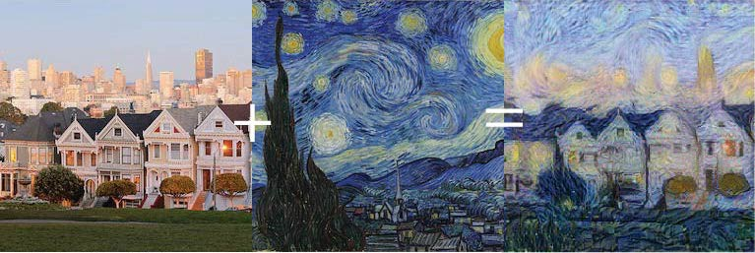
Artistic Style Transfer

Slide 3
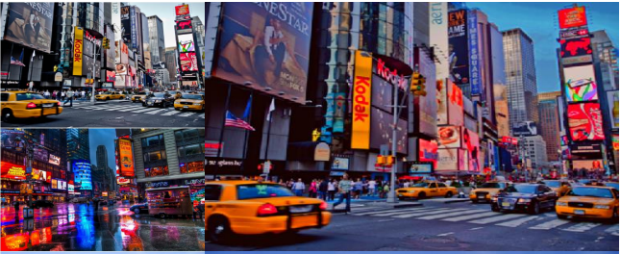
Photorealistic Style Transfer

Slide 4
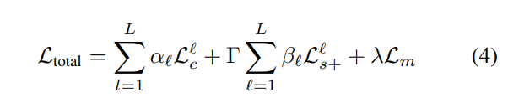
DPST
1) Photorealism regularization : penalize image distortion
-> Matting Laplacian
2) Augmented style loss with semantic segmentation : Gram matrix의 경우, 전체 이미지에 대해 계산되므로 spill over가 일어나므로 generate image segmentation mask
->Semantic Segmentation Mask

Slide 5
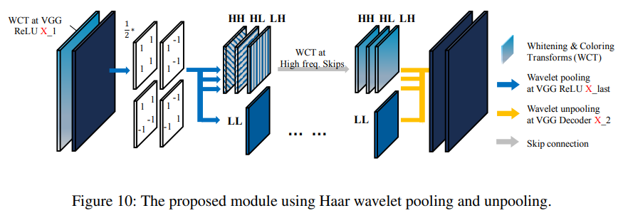
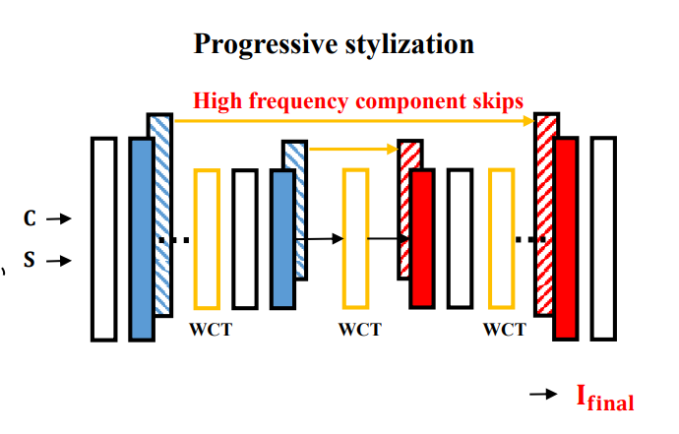
WCT2

Slide 6
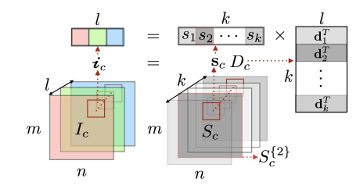


NL-MAT
$I_{c}∈ℝ^{m\text{×}n\text{×}l}$+ $I_{s}∈ℝ^{M\text{×}N\text{×}l}$ => $I_{cs}∈ℝ^{m\text{×}n\text{×}l}$
“To capture the non-local similarities, the entire image is
enforced to share the same set of color bases”
1 × l
1 × k
k × l
Color basis
Color basis matrix
Single pixel
coefficient
Proportions of the 2nd color basis
k>>l
Representation for entire image

Slide 7
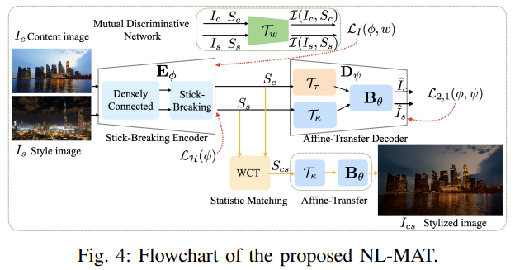
NL-MAT
Enforcing the correspondence of context-
Sensitive representations
with statistical matching
Executing local style transfer in a global
Consistent fashion with sparse entropy ftn
Decoupling of non-local representations
and color information
“Since the arrangement of adjacent pixels are untouched,
decoupling mechanism preserves spatial distribution.”

Slide 8
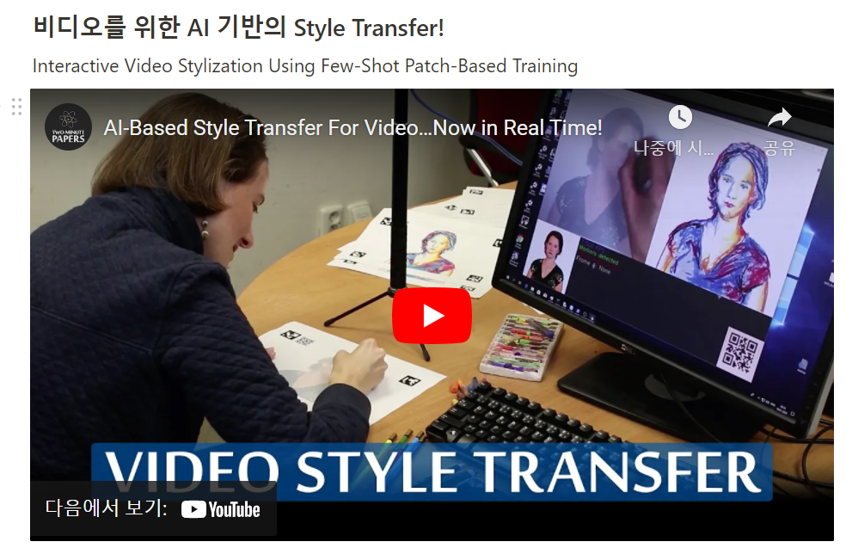
Video stylization

